Slide 1
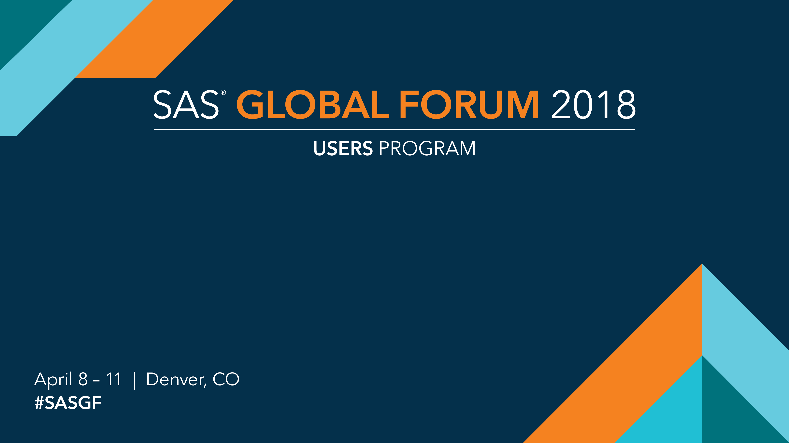
Writing Code With Your Data
Basics of Data-Driven Programming Techniques
Joe Matise, NORC at the University of Chicago
SAS and all other SAS Institute Inc. product or service names are registered trademarks or trademarks of SAS Institute Inc. in the USA and other countries. ® indicates USA registration. Other brand and product names are trademarks of their respective companies.

Slide 2
Writing Code with Your Data: Basics of Data-Driven Programming Techniques
Joe Matise, NORC at the University of Chicago
Code/Paper at https://github.com/snoopy369/SGF2018/
WHAT IS DATA DRIVEN PROGRAMMING?
STEPS IN DEVELOPING A DATA DRIVEN PROGRAM
Data-Driven Programming is the concept of writing code that in some fashion uses information stored either in a dataset or in the metadata of a dataset.
Examples of Data-Driven Programming:
Calling a report macro once for each region represented in a dataset
Creating one dataset for each value of a variable
Defining input file format in a dataset, and calling an input macro from that
Storing data variable code frames in a data dictionary, and creating SAS formats from that
Write the basic program without the data-driven elements
Identify elements that can be pulled from data, or that can be moved into datasets
Plug in macro variables for elements that will be drawn from data
Turn code into a macro (if not already)
Add code to create macro calls from data
COMMON DATA DRIVEN PROGRAMMING TECHNIQUES
Dictionary Tables
PROC SQL SELECT INTO
External control files
Data-driven formats and labels
ODS OUTPUT to pull information from PROCs
WHY DATA DRIVEN PROGRAMMING
A data-driven program will typically require less maintenance over time, as it can often be written such that no modifications to the program are needed for multiple iterations; only the data will change each time it is run.
A data-driven program is typically much shorter, meaning fewer opportunities to make typos or logic errors, and simpler maintenance when it is needed. It will also often take less time to write.
A data-driven program will be easier to understand for others, particularly for non-programmers. Rather than using complex logic or embedding large amounts of information in the code, the code can be short and easily read, and the data driving it can be stored in an accessible fashion.
Data-driven programs based on data stored in an accessible fashion can often be employed by non-programmers without a programmer’s intervention at all. The non-programmer can make changes to the data as needed for each iteration, and then simply run or schedule the program.
REFERENCES
Henderson, Donald et al, 1992. “Building Data-Driven Applications Using the SAS' Applications System: Selected Techniques”. Proceedings of SUGI ’92. Cary, North Carolina; SAS Institute, Inc. Available at http://www.sascommunity.org/sugi/SUGI92/Sugi-92-42%20Henderson%20Johnson%20Rabb%20Septoff%20Shusterman%20Smith%20Thornton%20VanDusen%20Yuan.pdf
Fehd, Ronald and Art Carpenter, 2007. “List Processing Basics: Creating and Using Lists of Macro Variables”. Proceedings of SAS Global Forum 2007. Cary, North Carolina; SAS Institute, Inc. Available at http://www2.sas.com/proceedings/forum2007/113-2007.pdf
Carpenter, Art. 2012. Carpenter’s Guide to Innovative SAS Techniques. Cary, NC; SAS Institute, Inc.
SAS and all other SAS Institute Inc. product or service names are registered trademarks or trademarks of SAS Institute Inc. in the USA and other countries. ® indicates USA registration. Other brand and product names are trademarks of their respective companies.

Slide 3
SAS and all other SAS Institute Inc. product or service names are registered trademarks or trademarks of SAS Institute Inc. in the USA and other countries. ® indicates USA registration. Other brand and product names are trademarks of their respective companies.

